Slide 1
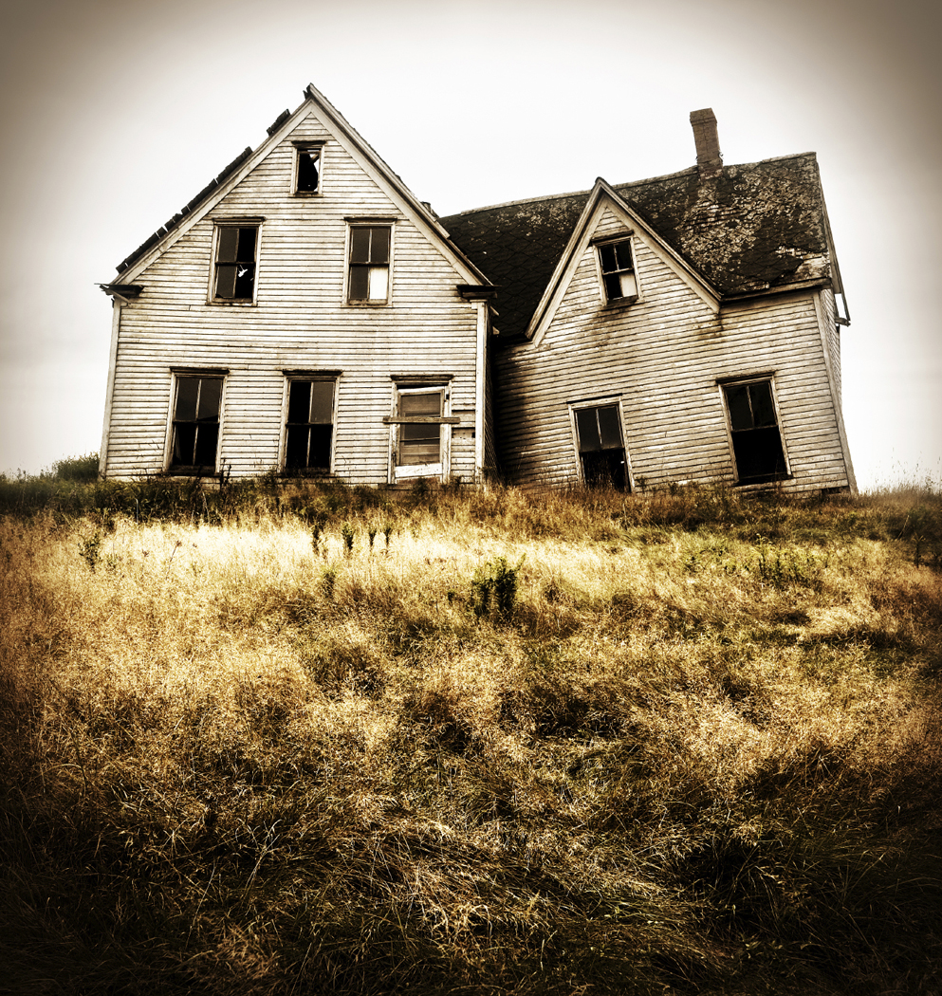

The Bunny and The Wolf
By Erica Fuhrmann

Slide 2
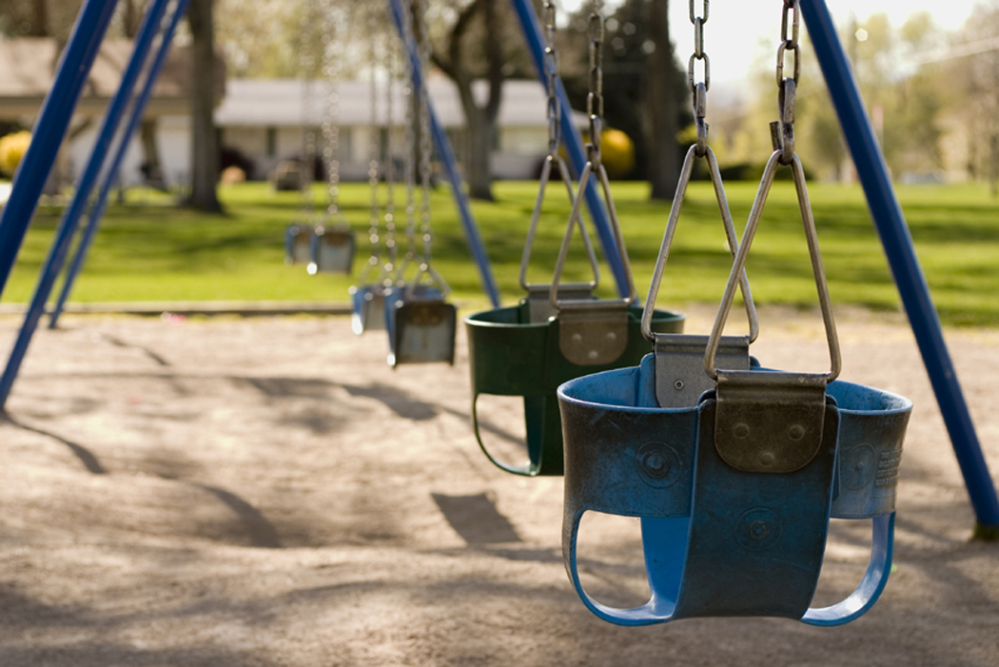
One day, there lived a poor lazy family of bunnies. The parents did not feel like working, so they had no money to spend or save. They lived in a very old rusty house.
When there only child went to the public park across the street in her old dirty clothes to try to have fun by herself as usual, she noticed a gang of very sneaky animals. Once she saw their faces, she instantly knew they were the neighborhood bullies. The Wolf was their leader!

Slide 3

No one ever went near him because of his harsh and cruel words. The bunny tried to run away but the wolf cried out,
“Hey where do you think you’re going!”
The Wolf had a furious look on his face. He sent out another howl,
“Get her Boys!”
All the rest of the dogs and foxes chased the rabbit into the end of the fence.

Slide 4


The bunny was trying to ignore the fact that she was pinned against a bunch of metal laced together. The wolf’s howls were to loud.
“ What is that, you are wearing!” the wolf shouted out loud.
“Yeah, you look like Cinderella before the fairy god mother came.” the fox added on.
The Bunny finally said,
“Your clothes are too fancy and no one likes a snotty rich person, anyway the point is Children are not to be blamed for the faults of their parents!”
The wolf and his gang agreed and back off and the bunny went home.

Slide 5


Children should not be blamed for the faults of their parents.

