Slide 1
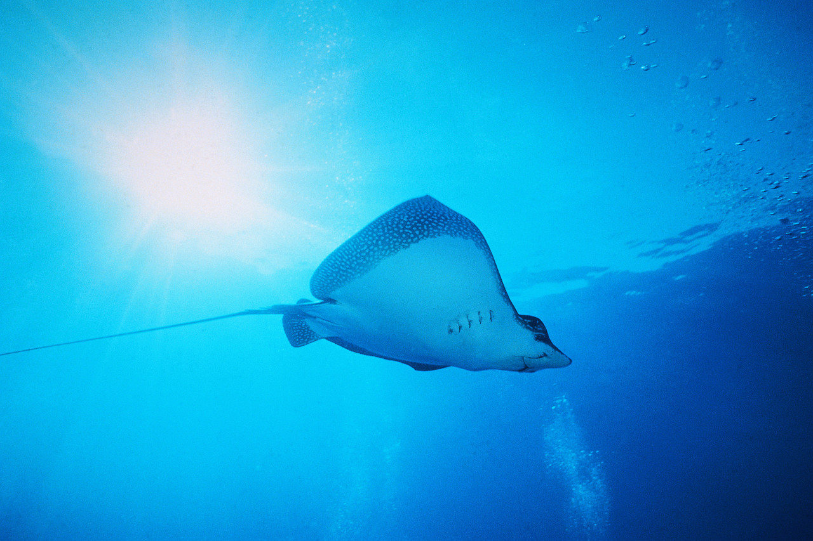
The mosquito fish and Catfish
By Michelle Williams

Slide 2
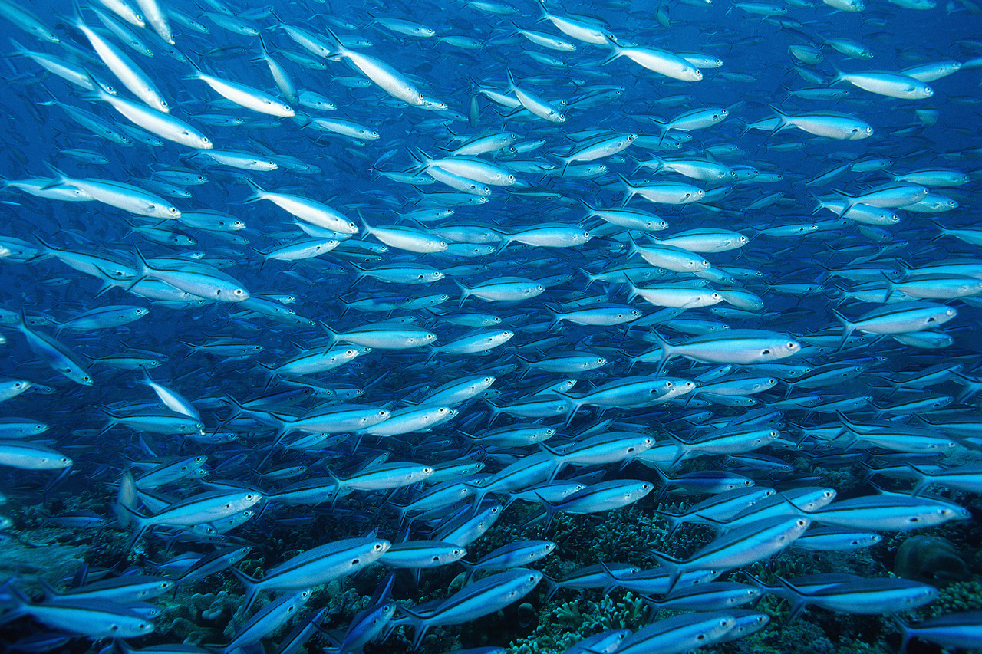

One day, a tiny misqutofish was swimming along in the great Pacific ocean. A mean catfish was looking for someone to pick On, so he challenged the puny ,slow fish to the tracks. “Mowa ha ha”
laughed the catfish, the misqutofish said” I will win this race”!
Still the little fish was slow and weak.

Slide 3
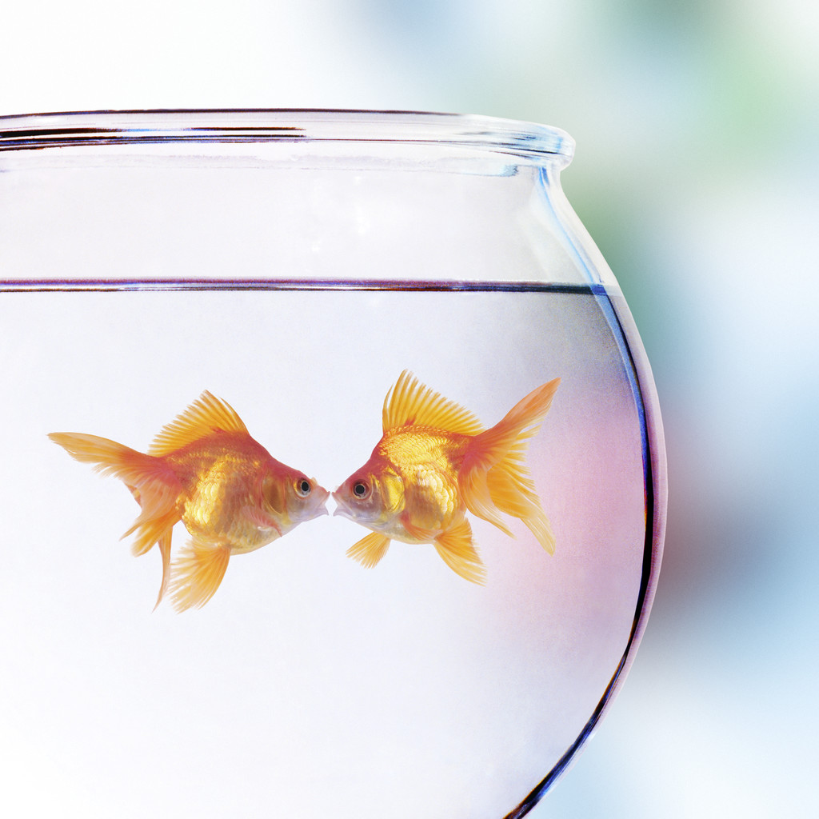
The day had come, the misqutofish v./s. the Catfish, as the little fish was warming up for the whole week, the mean Cat fish ate his favorite snack , algae covered plankton with big chunks of elodea around it. Both lined up as the Catfish is burning his energy warming up at the tracks, the Misqutofish just laded back and relaxed to save energy .

Slide 4

Later , the referee announces ,” Misqutofish is in the lead with much energy”.
As the Misqutofish crosses the finish line , the catfish had realized, he had lost and needed energy and not to under estimate anyone no matter how small.

Slide 5
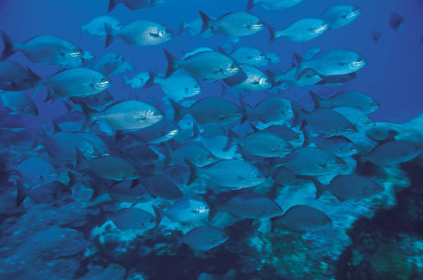

Even if your small you can still be strong

