Slide 1
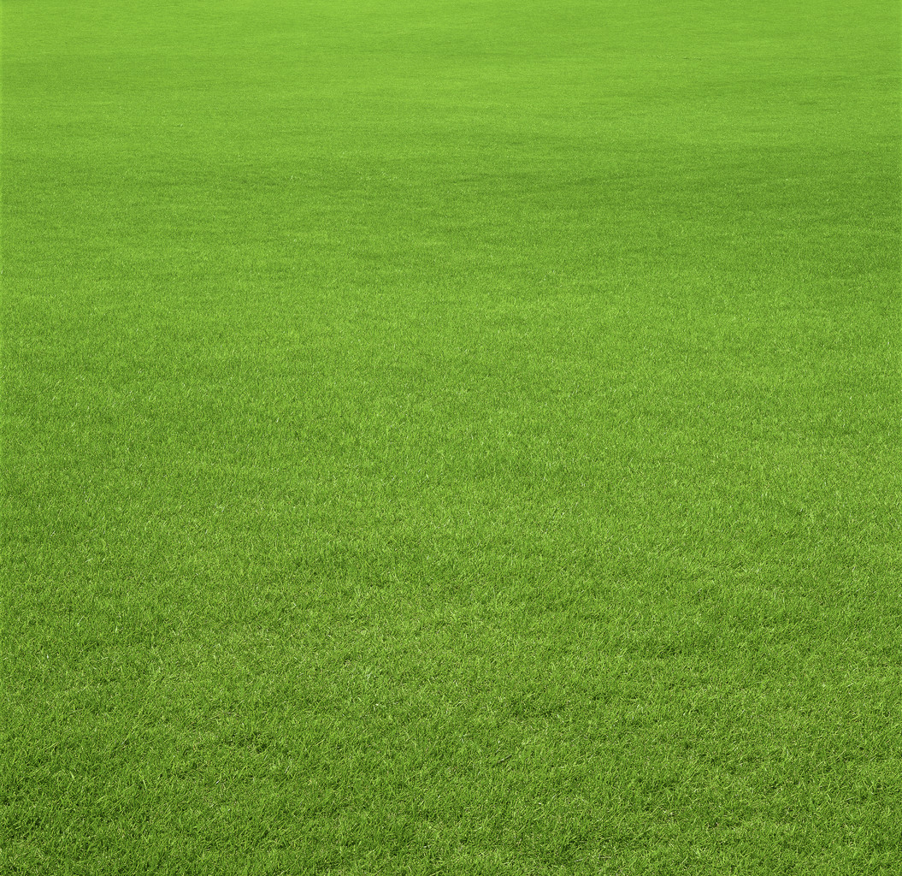
The Bear and The Cricket
By Evan Summers

Slide 2
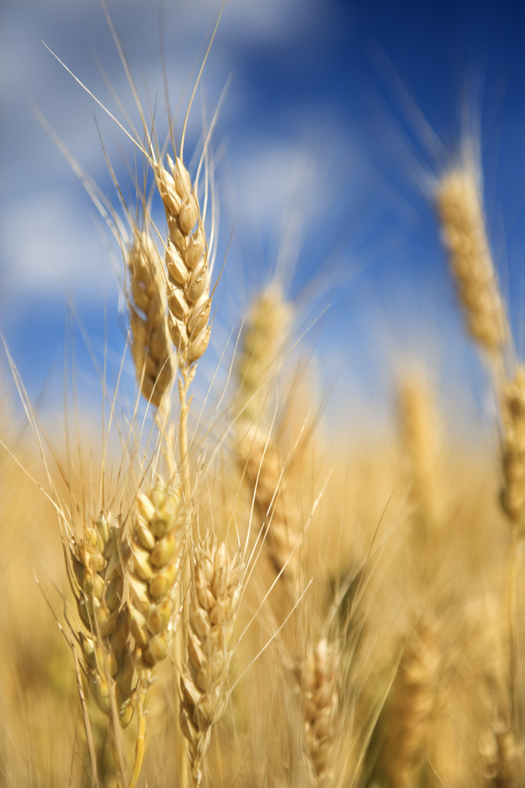
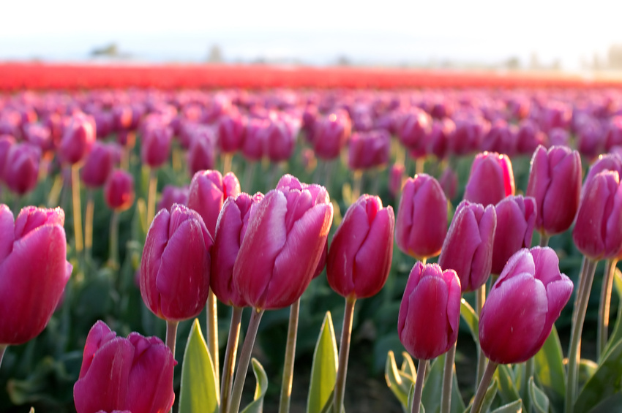
One day a small green cricket was coming back from the west side of the field back to his home, the east side. As the cricket grew nearer to the east side he spotted the lazy bear lying down at the stump of a tree near his garden. The cricket decided to trick the bear because of is laziness.

Slide 3
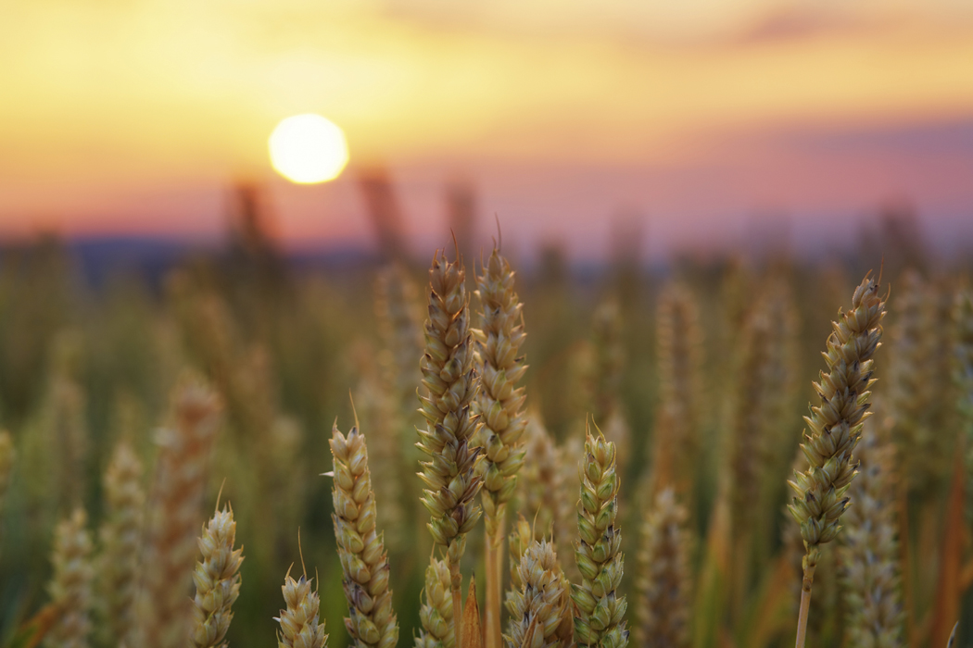
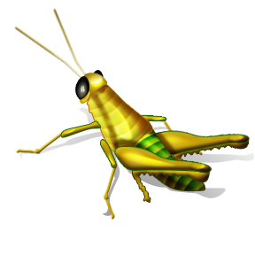
“Hello Mr. Bear would you like to go to the west side with me?” asked the cricket.
“Sure, but let me take my nap right now.” answered the bear slouched over.
“Well I’m sure you’ll be happy to hear that the west side is full of delicious food.” said the cricket.
“Okay, I’ll come.” agreed the bear.
“Then follow me.” chirped the cricket.
The two animals traveled to the west side of the field together.

Slide 4
When they arrived the bear was furious his face was bright red. The entire west side was grass! Nothing else, just grass! The bear glanced down at the cricket. The cricket ignored the bear and happily hopped into the field.

Slide 5
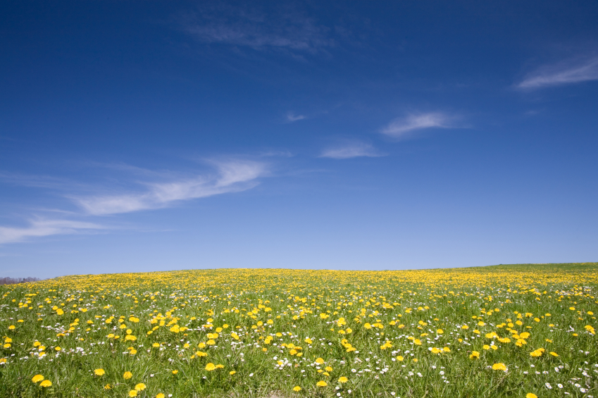
What has value to one is worthless to another.

